Slide 1


DATA221 Intro Machine Learning 09 K-nearest-neighbor classifier
William Trimble
Spring 2022

Slide 2
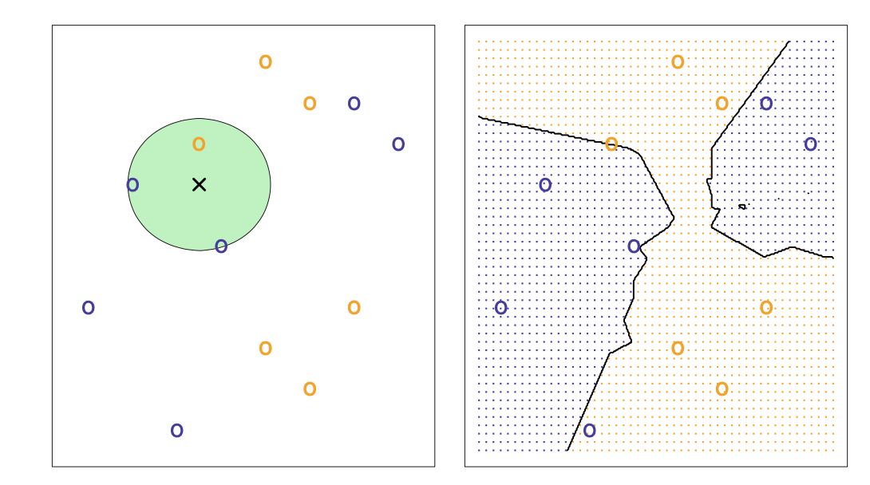
KNN classification : what do you need to be able to do to pull this off?

Slide 3
KNN classification : What does the green circle mean?

Slide 4
KNN
Always put attention on the distance metric.
Gets more accurate with increasing n (at constant n/N) but becomes very slow.
Tends not to work well in high numbers of dimensions. Why? Density of training points in high-dimensional space is low; will tend not to have examples that are alike enough.
Prototypical high-dimensional space is bag-of-words. 10,000 parameters for starters. (Spam classifier)

Slide 5
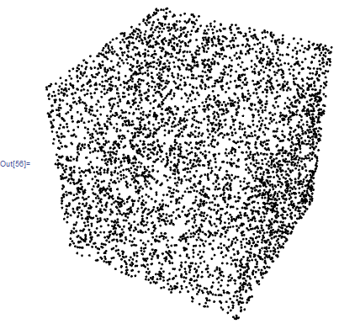
Curse of dimensionality
Things don’t work in high numbers of dimensions the way we expect them to.
Computing n 1st derivative components and keeping track of n(n+1) 2nd derivative components is not the worst of our troubles.
Data become sparse in vast high-dimensional spaces (where machine learning parameters live)
Limited data .. all linear combinations of N data points in ℝ^{D} allow only vectors in an ℝ^{N} subspace
In high dimensions it’s clear you don’t have the data to do combinatorical tests. When 2^{D} >> N situation is hopeless and there are always dimensions you never sample from.

Slide 6
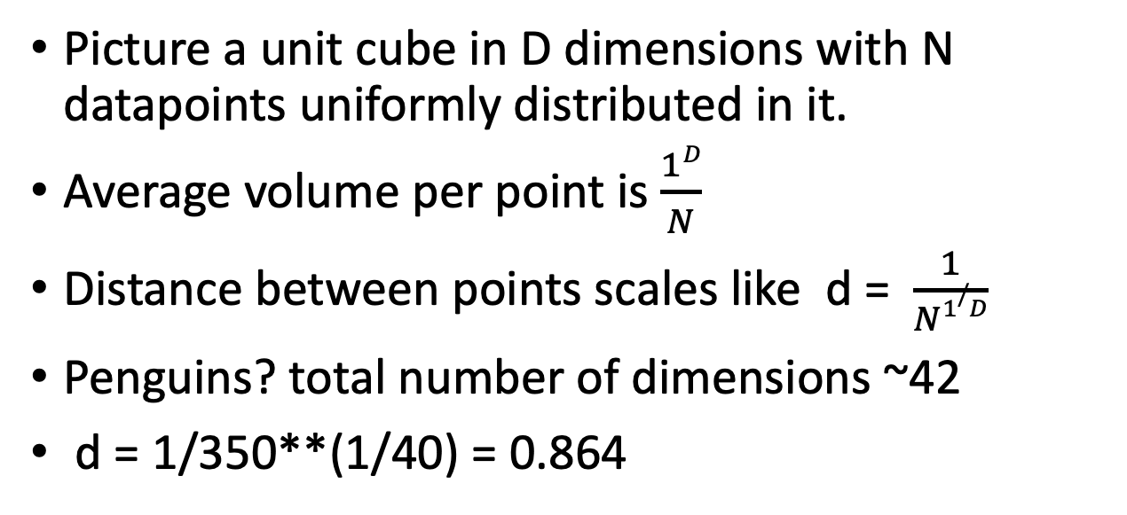
Curse of dimensionality…
Picture a unit cube in D dimensions with N datapoints uniformly distributed in it.
Average volume per point is $\frac{1D}{N}$
Distance between points scales like d = $\frac{1}{N1/D}$
Penguins? total number of dimensions ~42
d = 1/350**(1/40) = 0.864
To get just 1/350 of the data, I need a cube 0.864 on a side? This is a huge fraction of the span of each dimension.
It will take a very large radius just to capture on average a handful of datapoints, and my nearest datapoints may not be very similar.

Slide 7
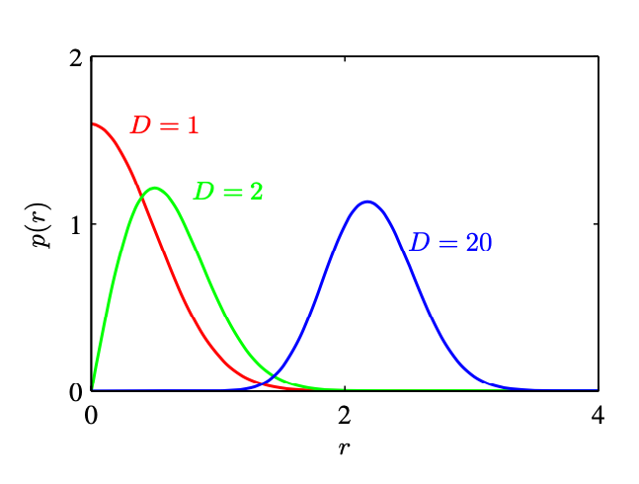
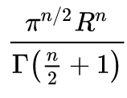
Multivariate normal, how bad can it be?
The volume of a sphere in N dimensions is
Surface area is proportional to R^{n-1}
MVN density centered at 0 in D dimensions, but the vast majority of the probability density is in a shell at the surface where the terms in x^{D}exp(-x²) balance.

Slide 8
Features and labels as matrices…
r features
n labels
X
Y
n examples
n examples / individuals / observations
n x r
n x 1
This is the form a lot of our library functions will expect.

Slide 9
Features and labels as matrices…
r features
X
Y
n examples
n examples / individuals / observations
n x r
n x 1
new X
1 x r

Slide 10
Distance matrices
r features
X
D
Y
n examples
n examples
n x r
n x n
n x 1
D
new X
1 x r
n x 1

